Slide 1


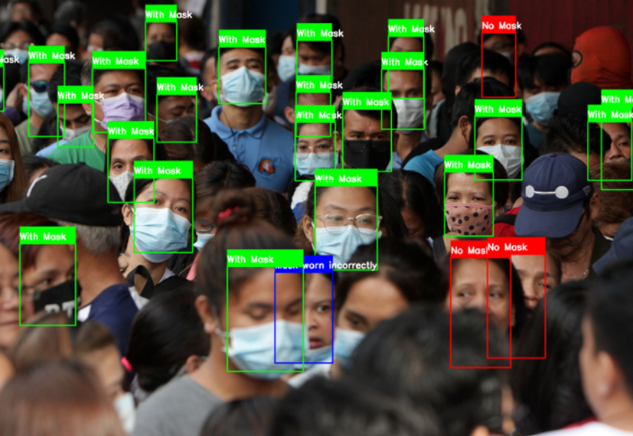


Project Andromeda
Smart Mask Detection System through CCTV feeds.
Detecting Mask(using face recognition) in crowds, at the school/office building entrance and other alerts.

Slide 2
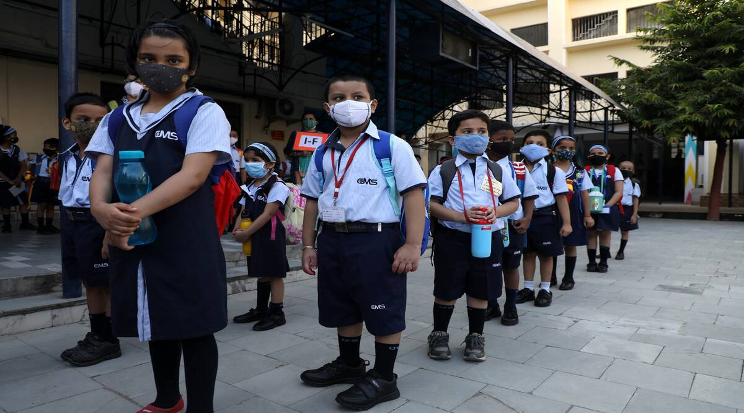
The Concept
We all have been through the tough times of covid. During the time of Covid there was a huge fall in the economy of the world as most of the work places such as Schools, Offices, etc were closed.
To prevent this pandemic in the upcoming future our project will help to detect suspects of people suffering from covid and allow us to take preventive measure to stop the spread of the disease.

Slide 3
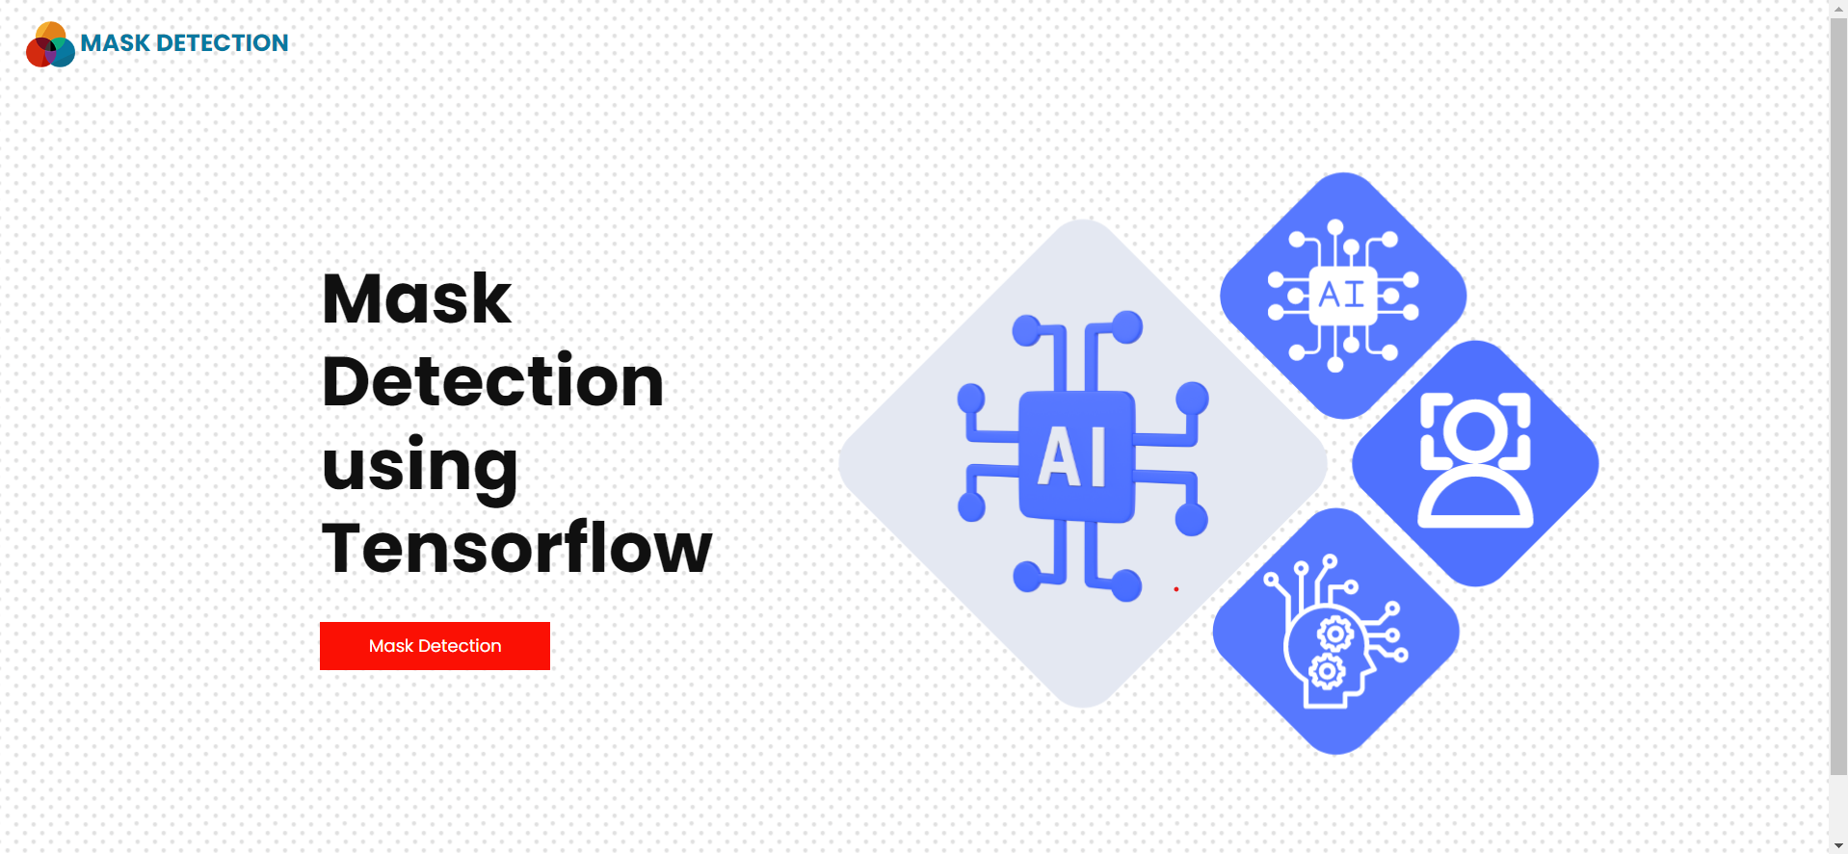
Solution Idea
Building a software which will detect the mask of the people entering in groups using face recognition through CCTV feeds. The models will be trained on Intel optimized scikit-leaarn and tensorflow libraries

Slide 4
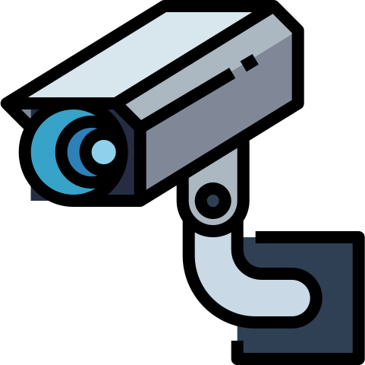






How it Works?
IP Camera
Facial Mask Detection
CCTV Feed
Open-CV + ML Models
Encoded Frame
ML Response
Response Data Stored if requirements are false
Records Found?
Other IP Cameras

Slide 5
Core Concepts
Facial Identity:
Mask Detection:
The administration can store student's/ employee's facial identities in the server.
The administration can take the attendance with the face-detection function using CCTV feeds
Alerts are also given to the Dept./ Organization Head whenever someone enters the building without wearing a mask.

Slide 6





Core Technologies
Frontend : HTML, CSS, JavaScript
Backend : Django
ML/DL Libraries:
Tensorflow, Keras, Open-cv

Slide 7
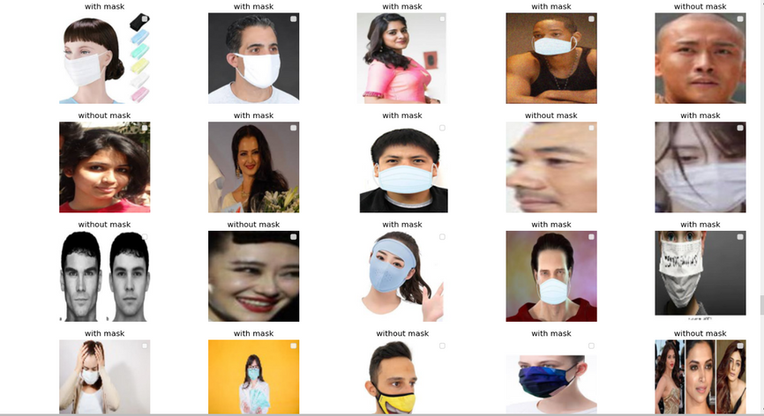
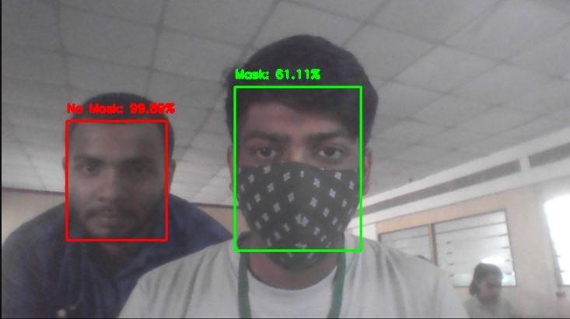
Working Model

Slide 8
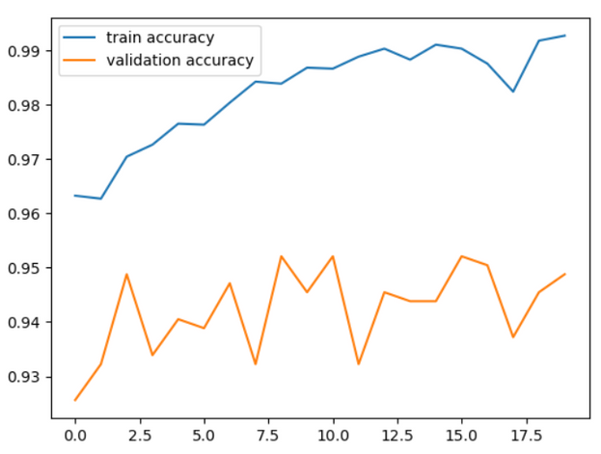
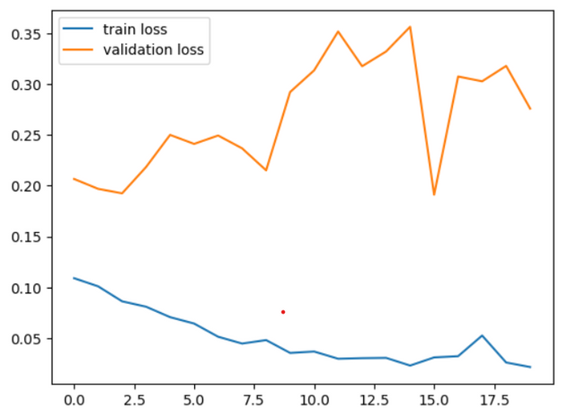
Model Accuracy
SVM-based model:
Tensorflow-base model:
The SVM based model has been made with Intel optimized scikit-learn library.
The model has an accuracy of 96.98%
The Tensorflow-based model is trained on Intel's DevCloud platform and has been deployed in a website using django framework. The model has an accuracy of 94.83%

Slide 9
GitHub Repo:
https://github.com/Ripan-Roy/deploy-enigma

Slide 10
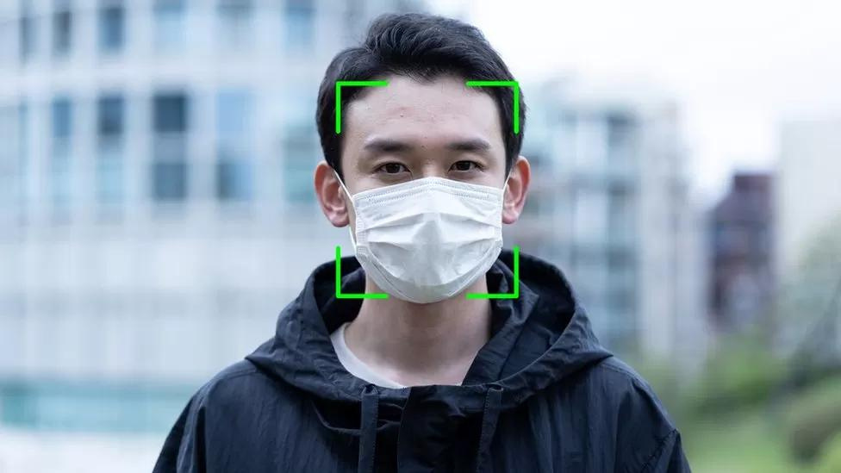
Future Plans
36.8 °C
Acccording to my research, till now there are only two countries which have made a software which detects and reccognizes faces even when a person wears a mask. Our aim is to make such a software in India as well along with the additional features mentioned.
A feature which predicts the demography of any unknown person who passes in front of the desired CCTV and alerts the admin.
25, Male

Slide 11


Team Members
Ripan Roy
Techno India University
B.Tech CSBS, 3rd year

Slide 12
Thank You
For Watching

